Slide 1
Share feedback
HSIEH PI-CHIA

Slide 2
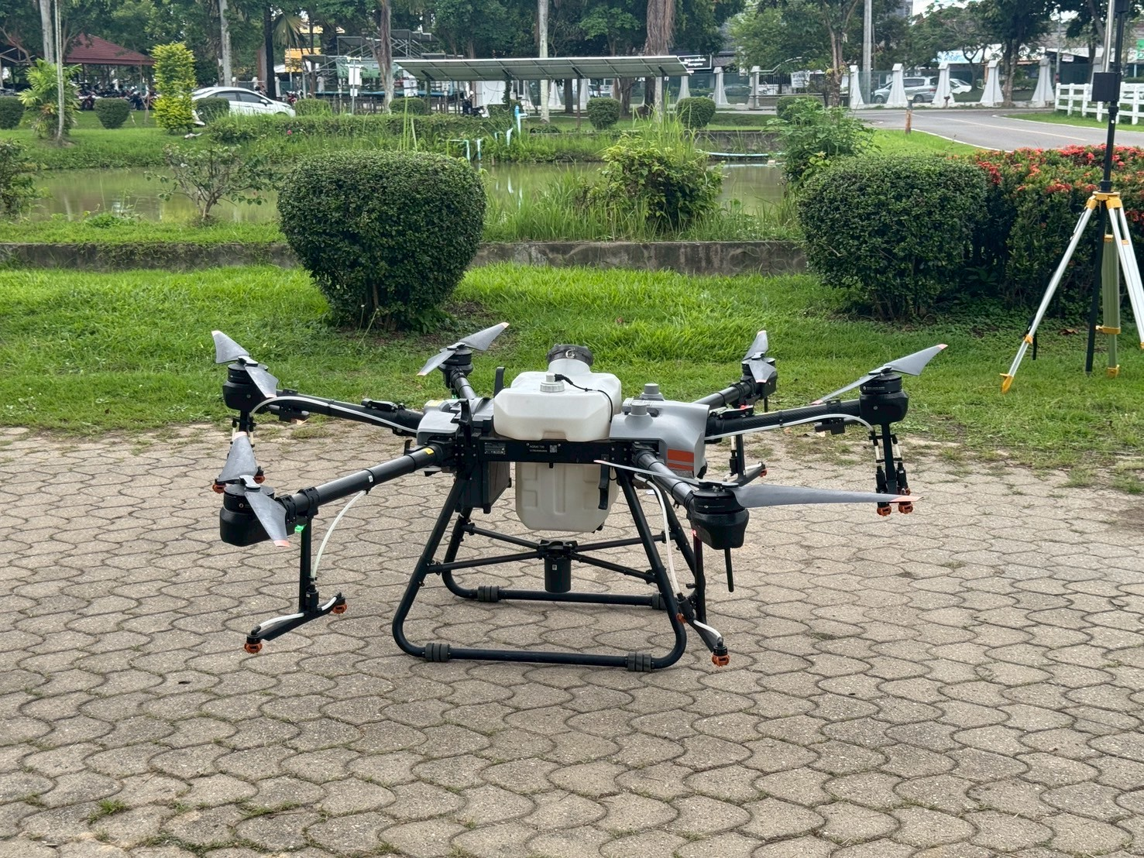
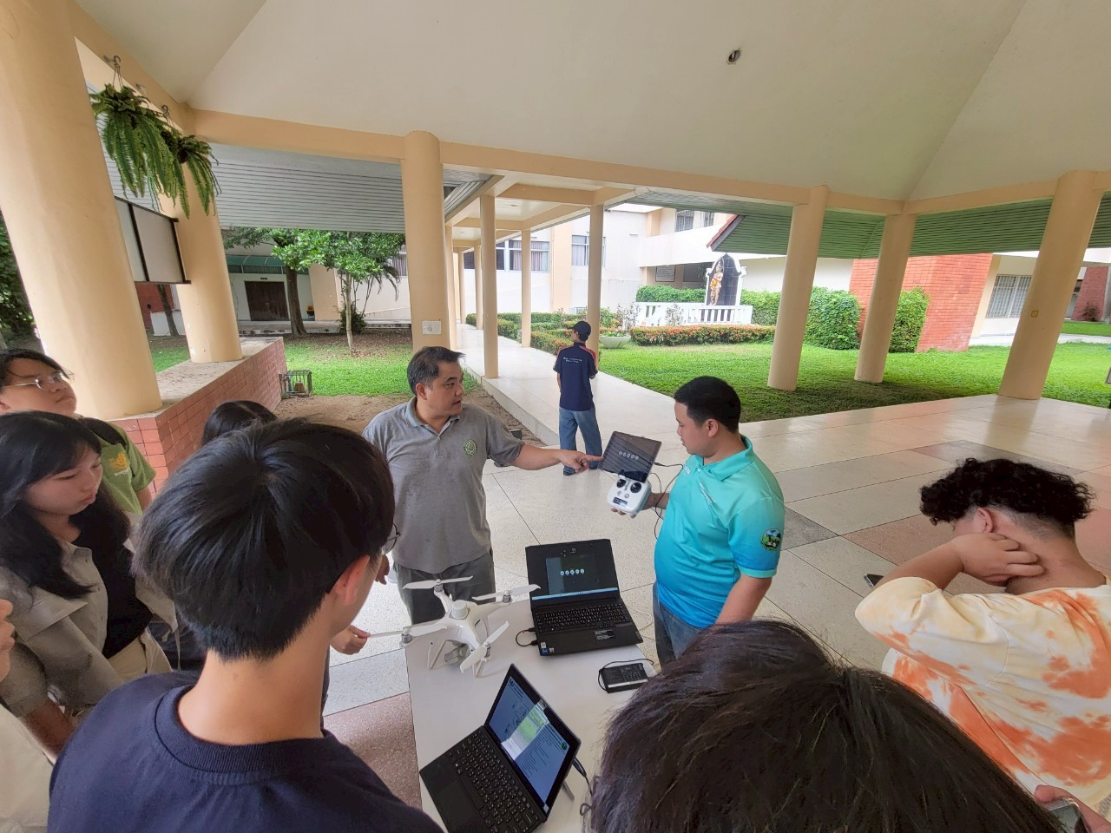
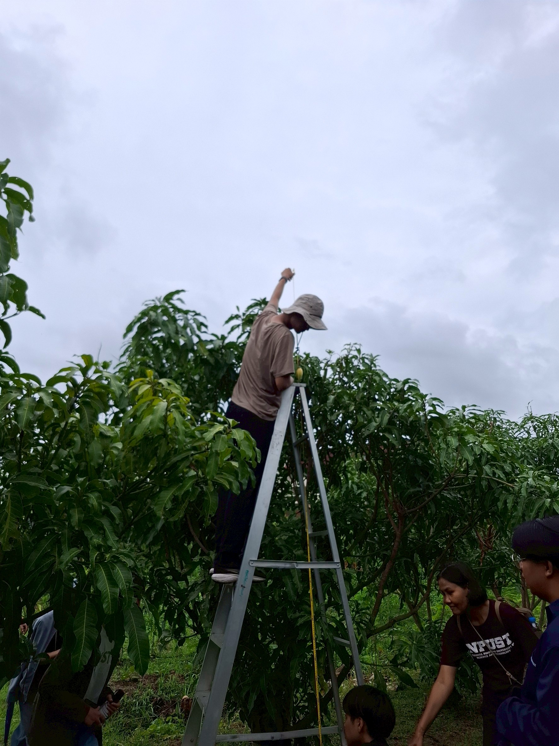
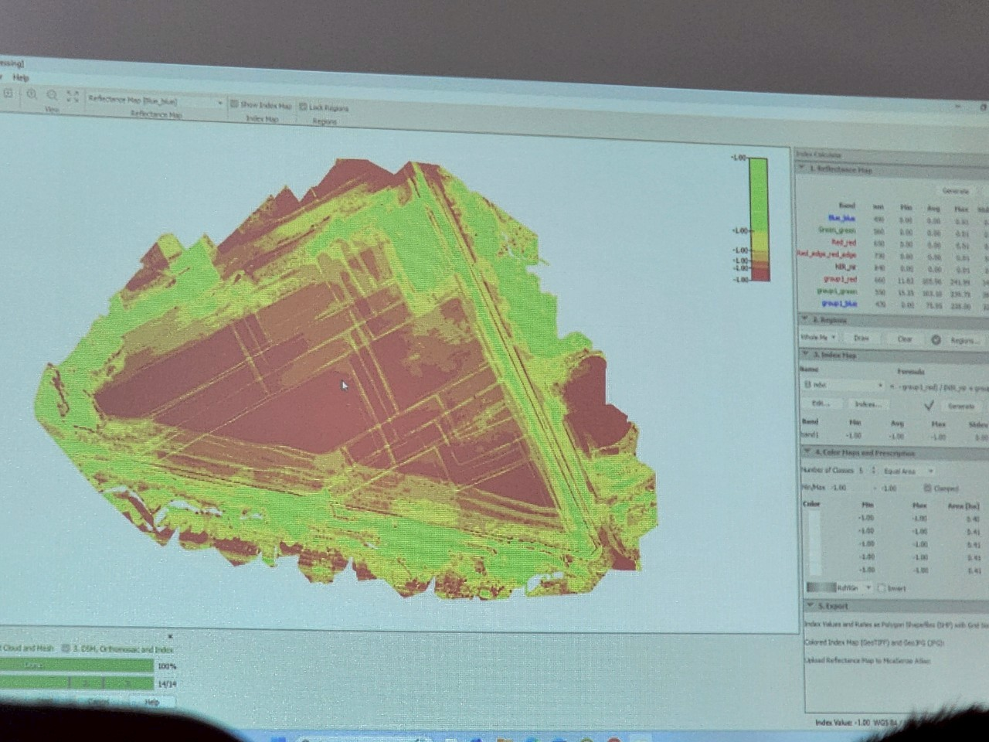
Drones

Slide 3
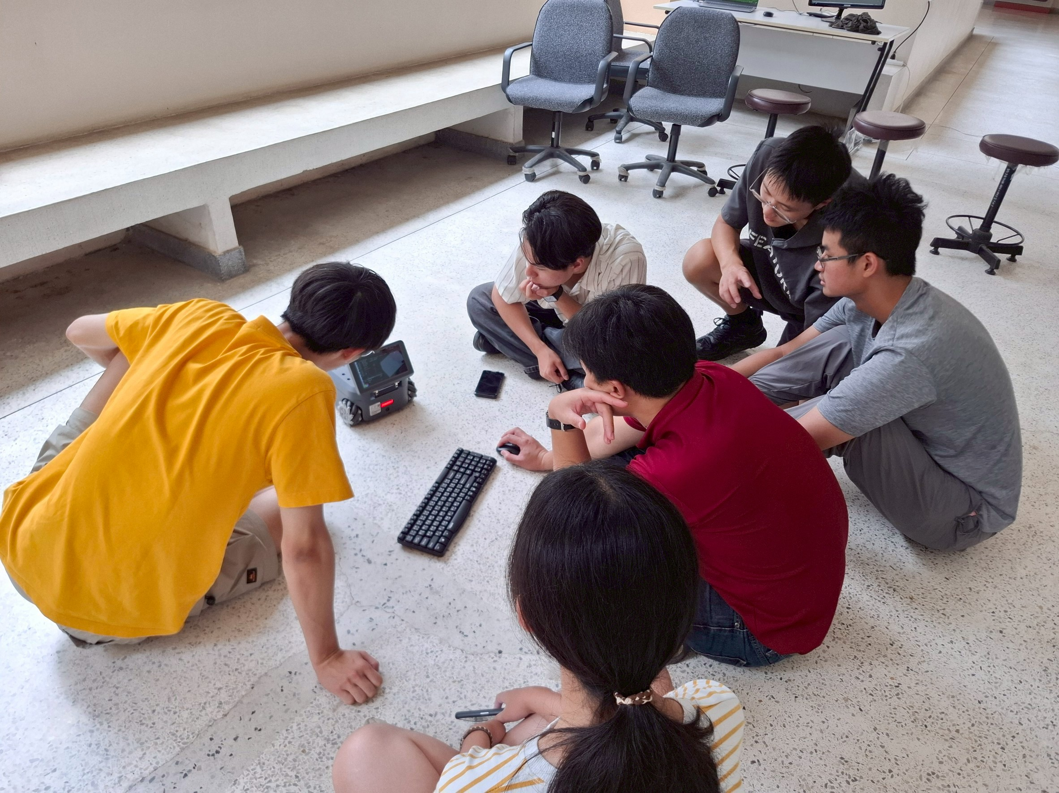
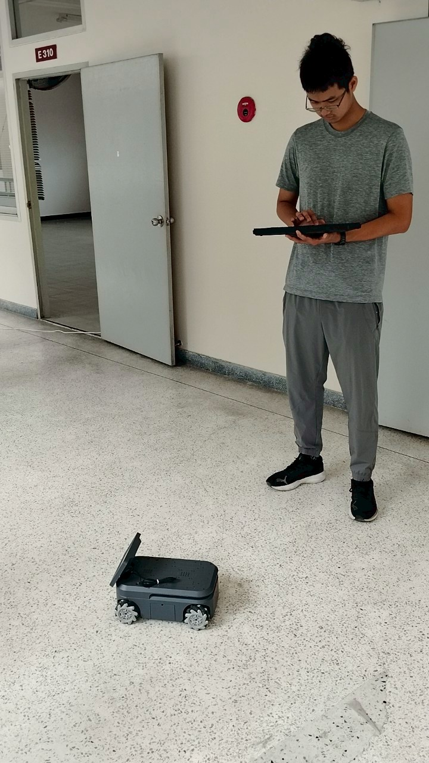
AMR porject

Slide 4
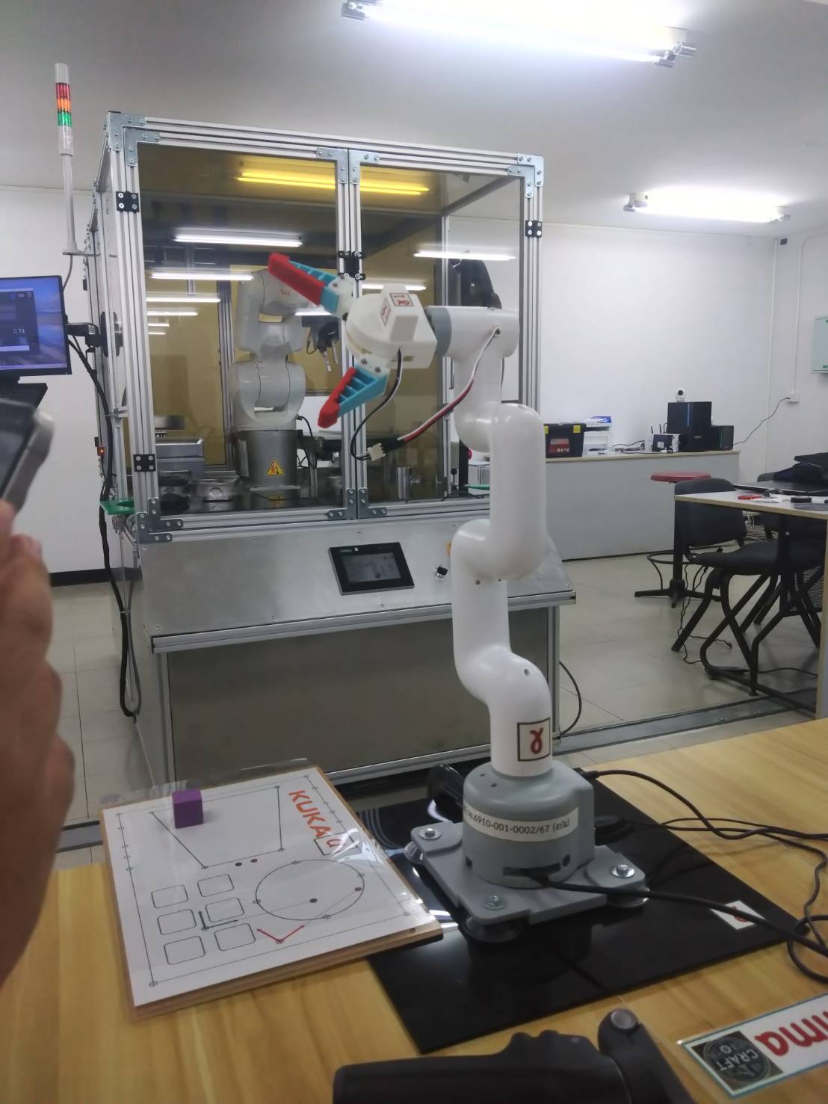
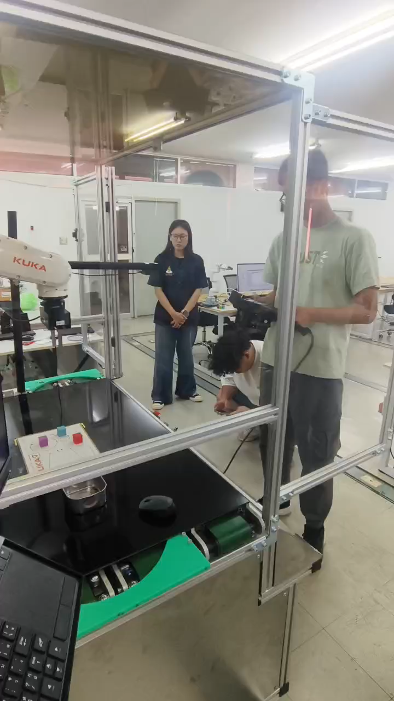
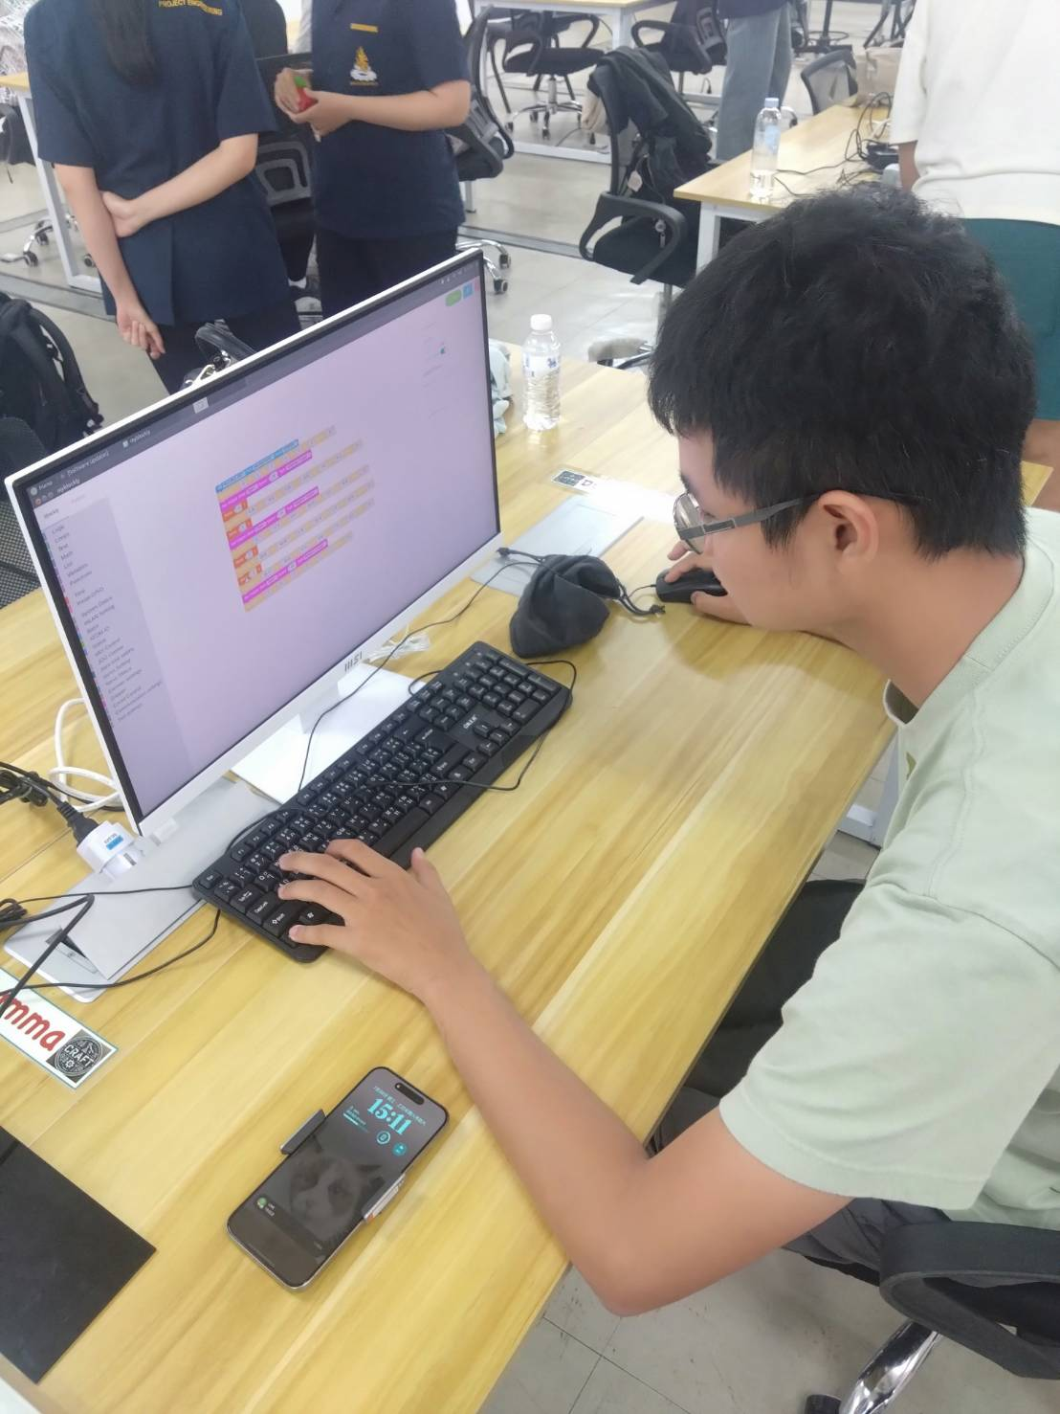
Roboit arm laboratory

Slide 5
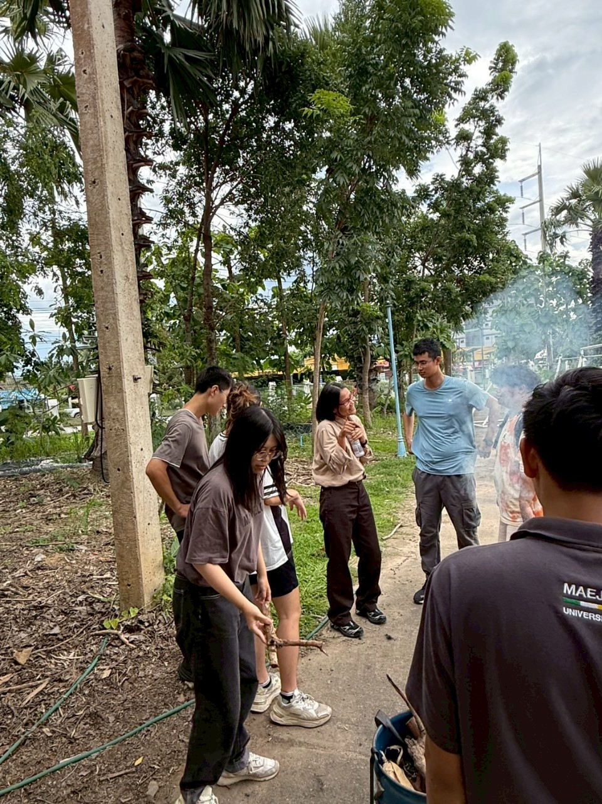
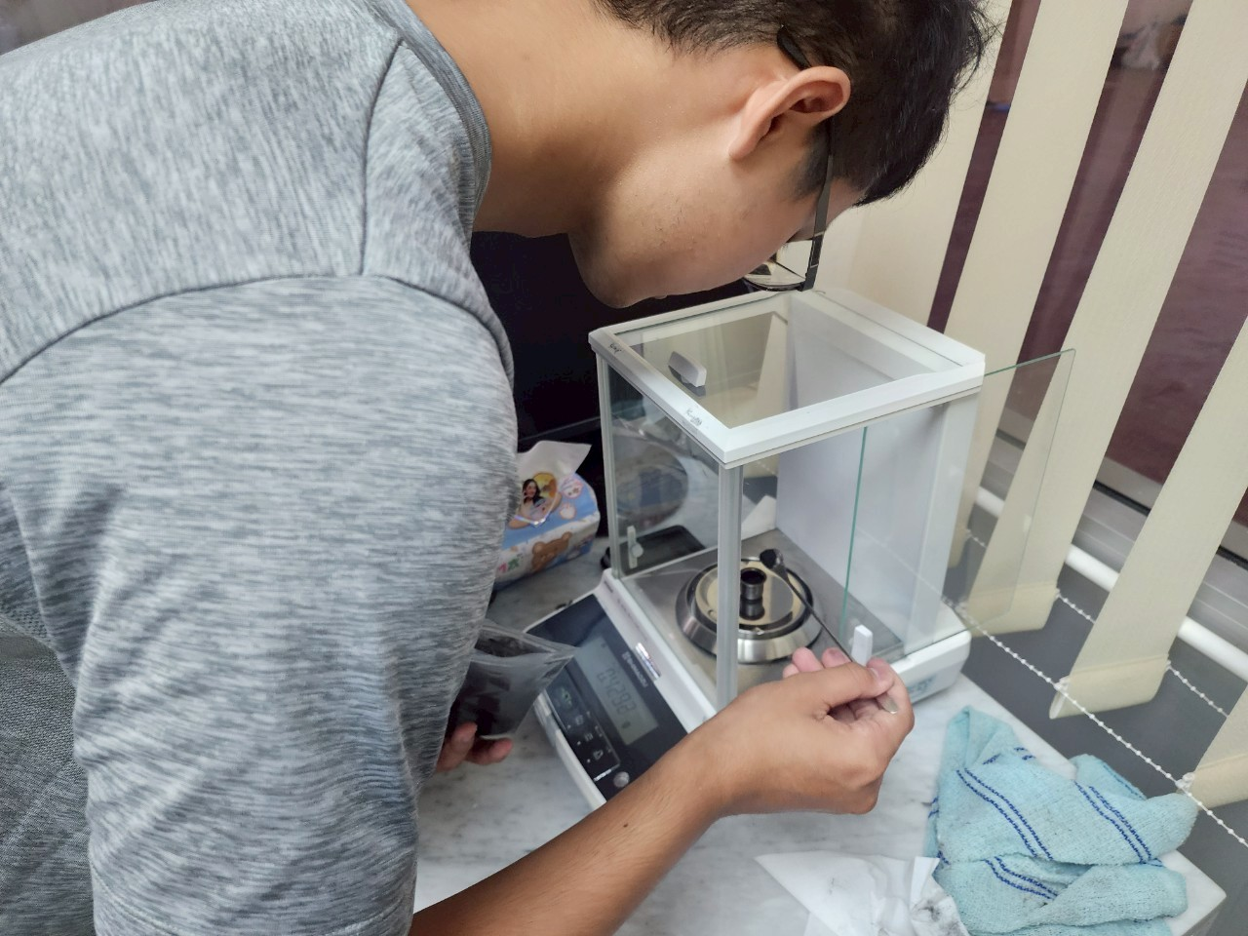
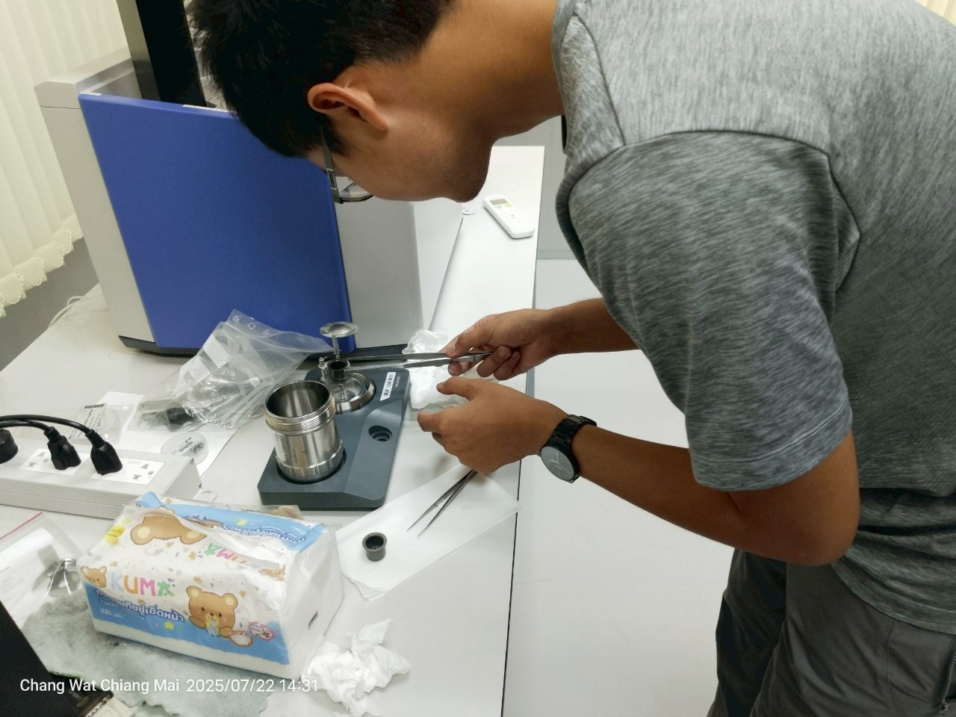
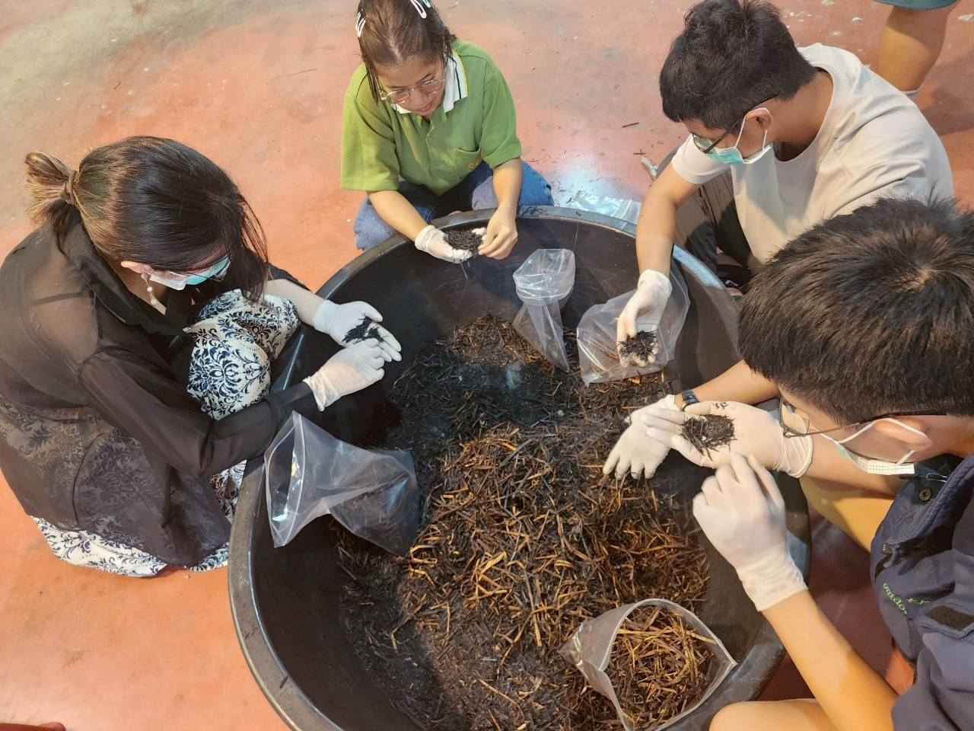
Making biochar

Slide 6
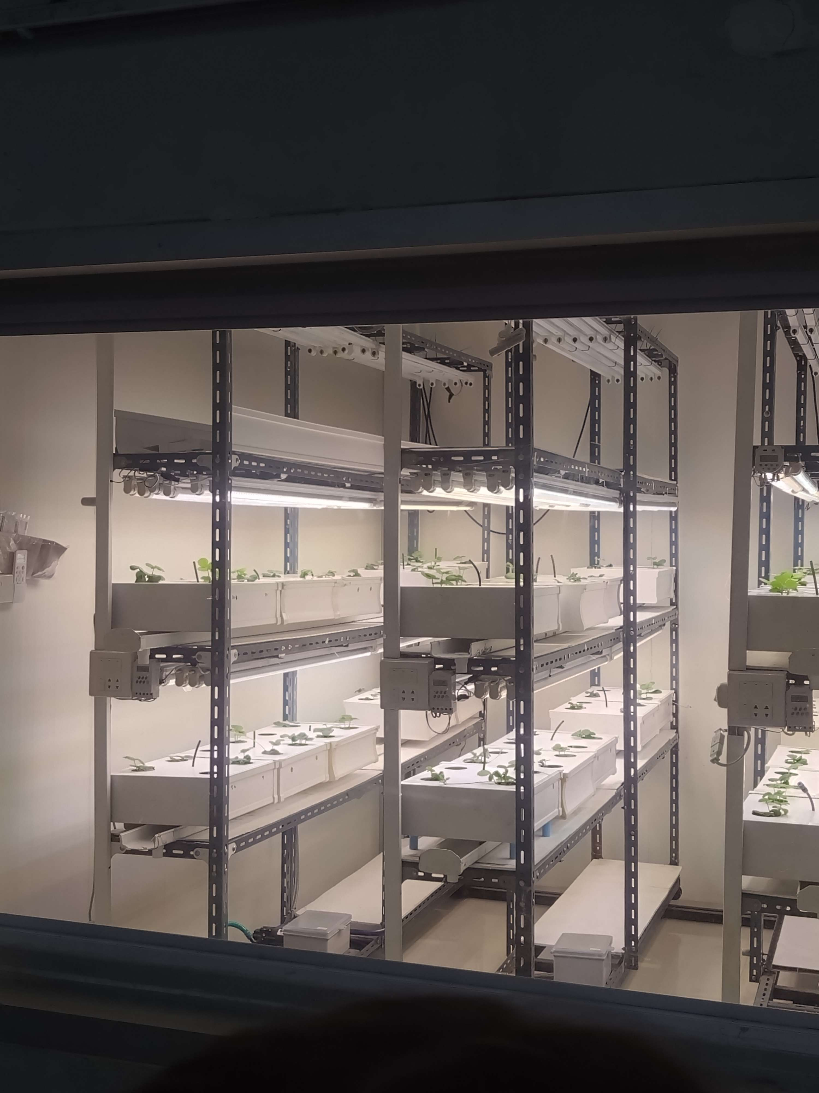
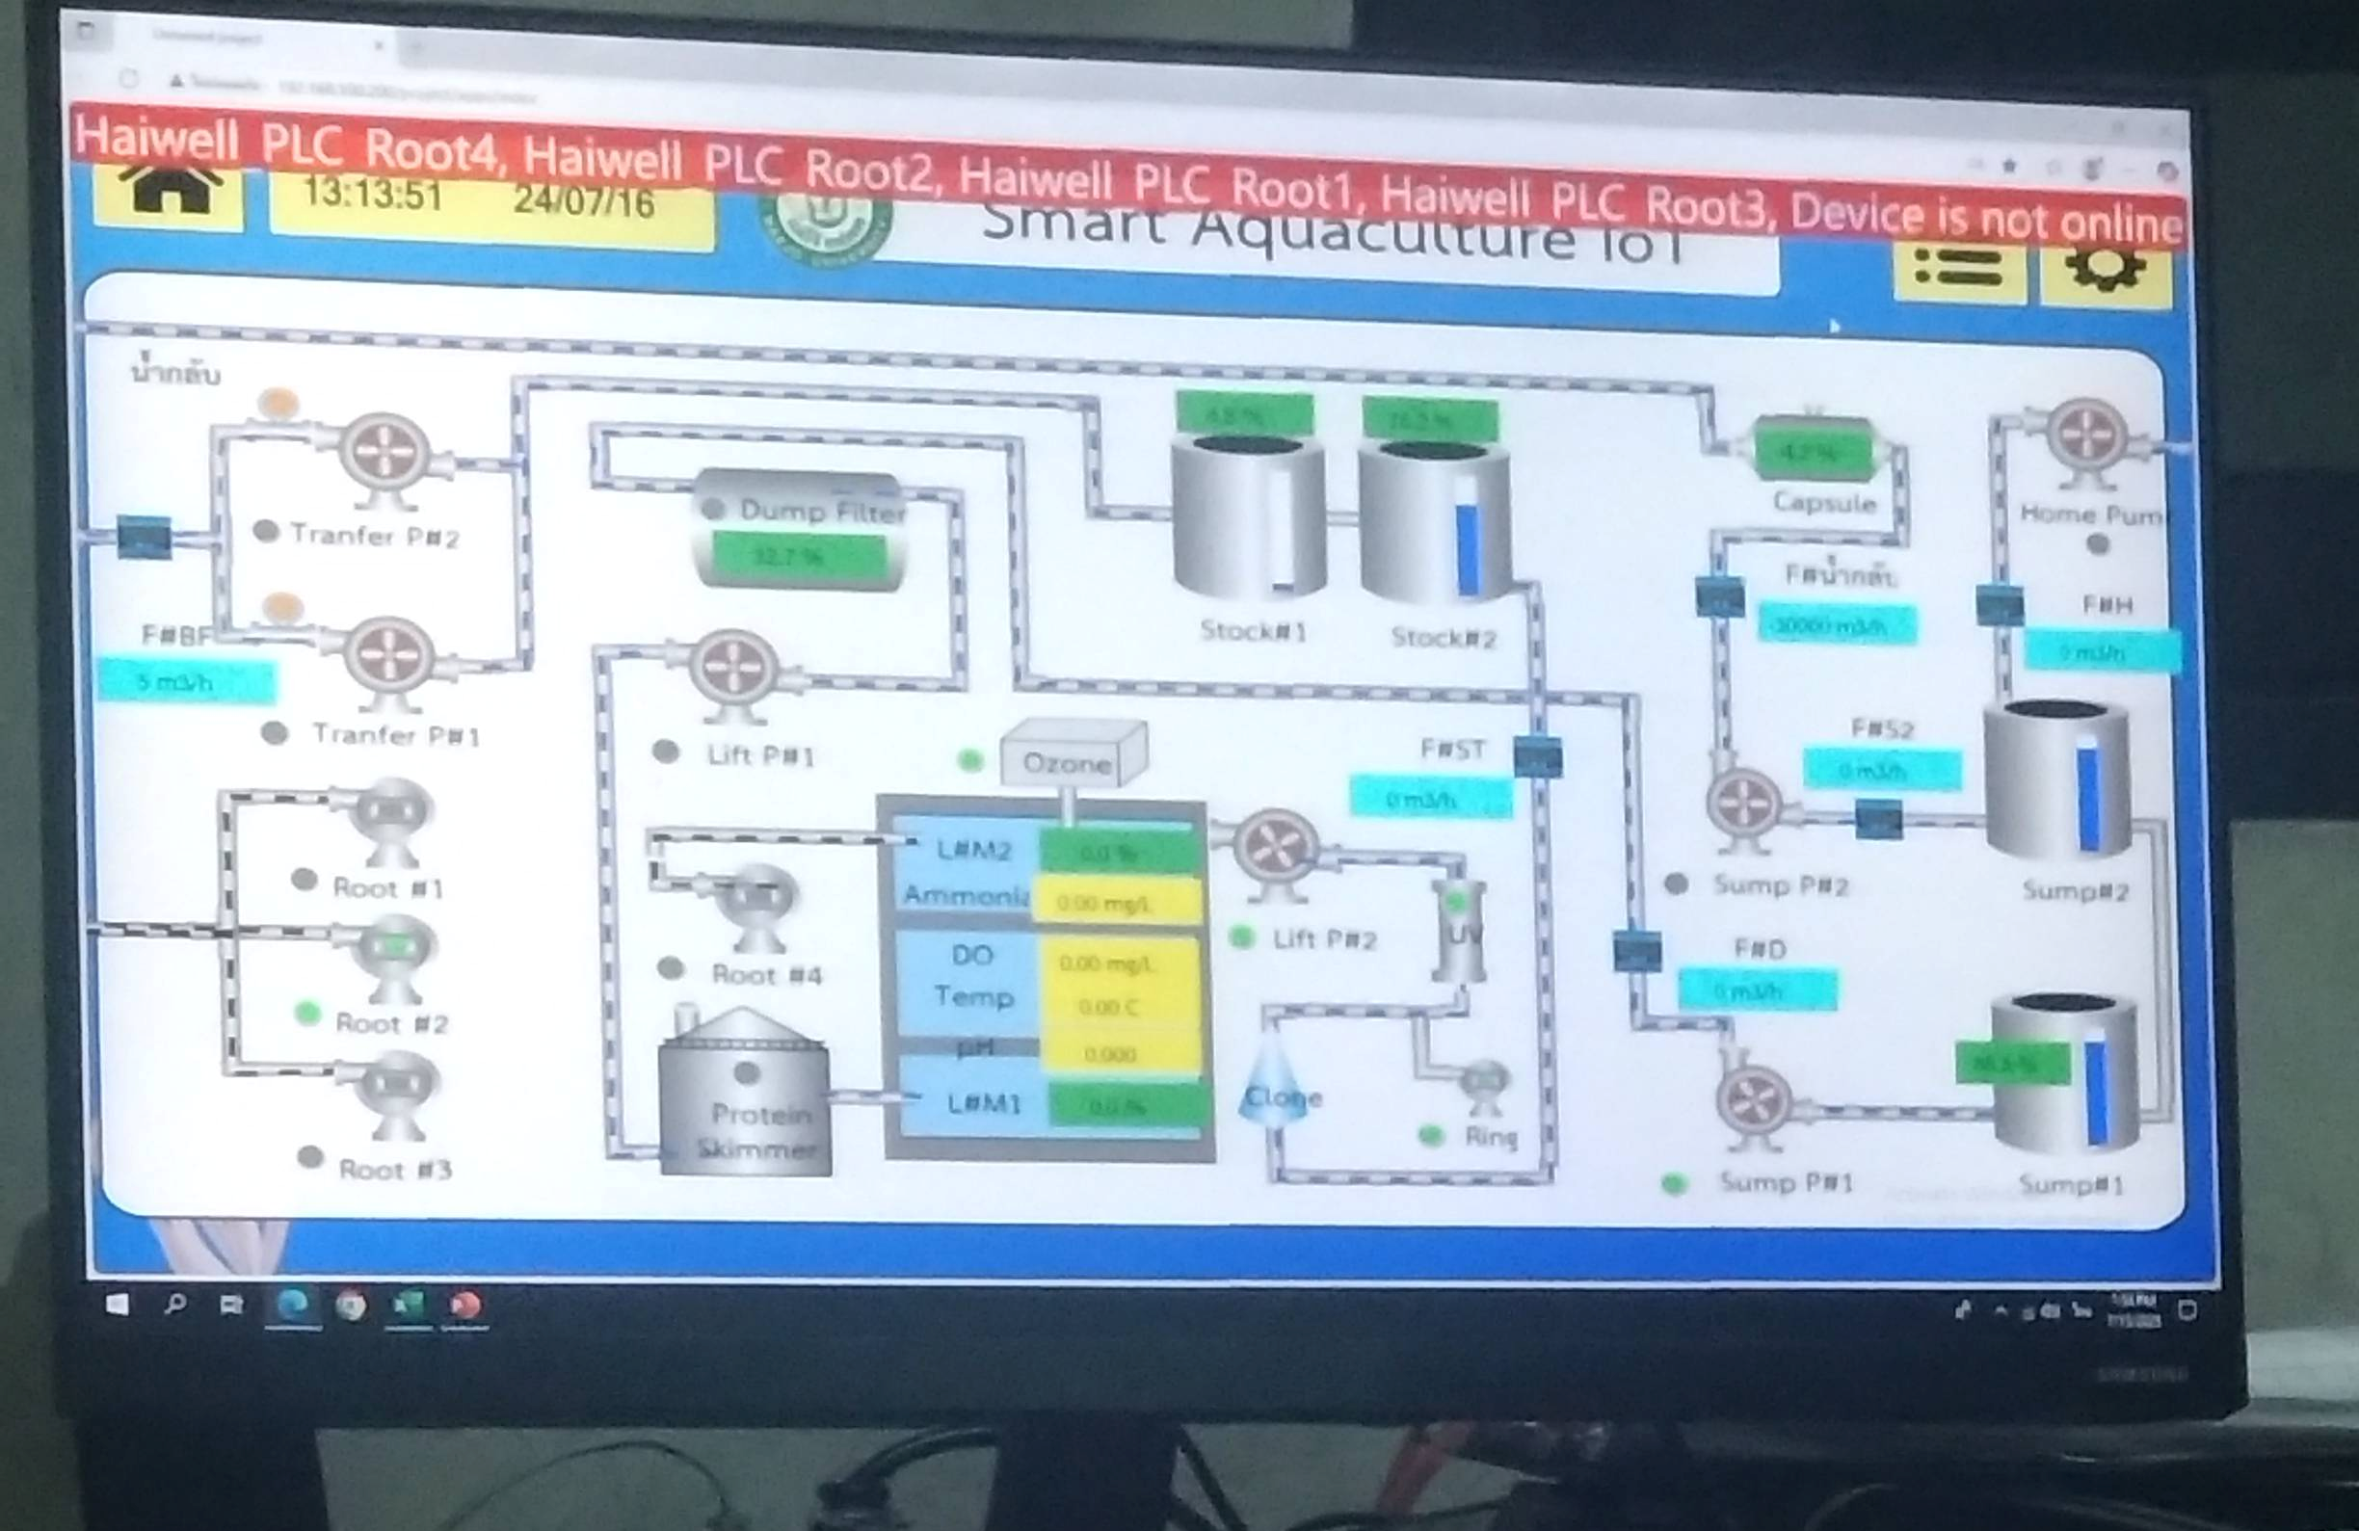
IOT system

Slide 7
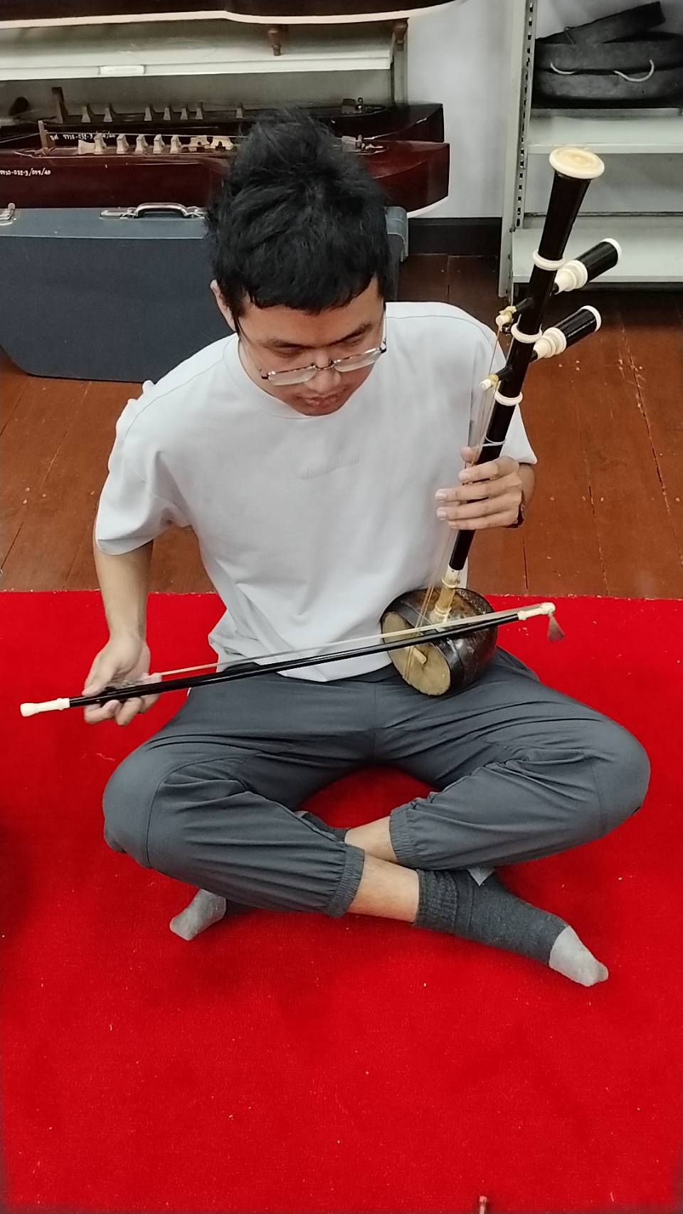
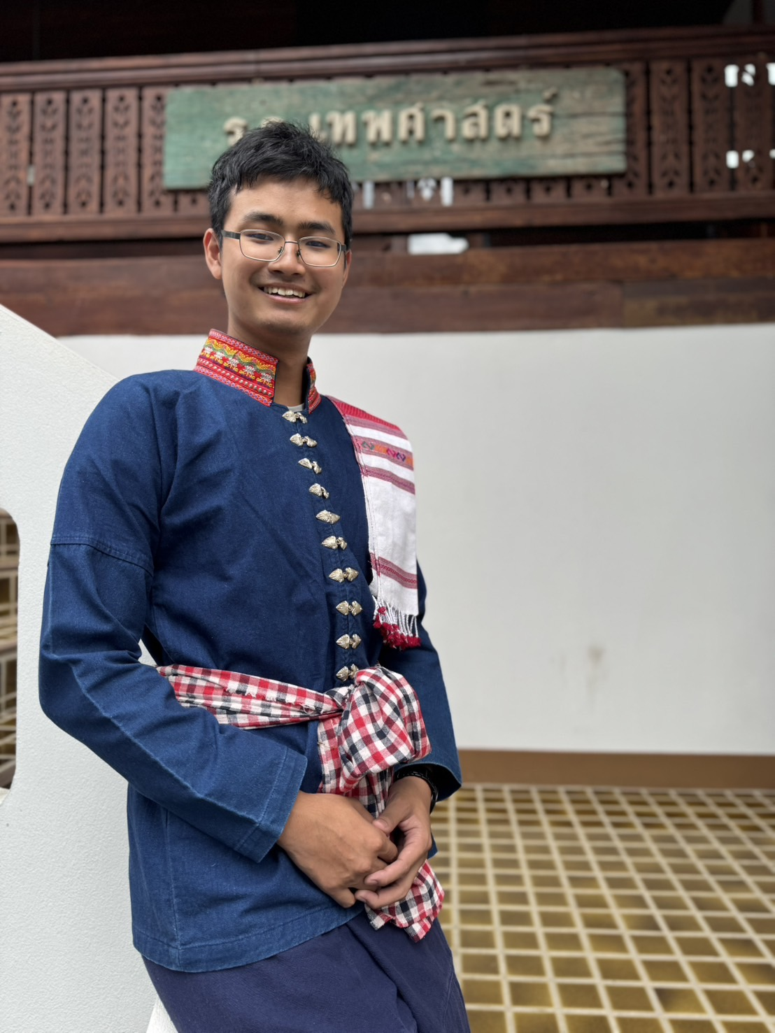
Thai cultural experience

Slide 8
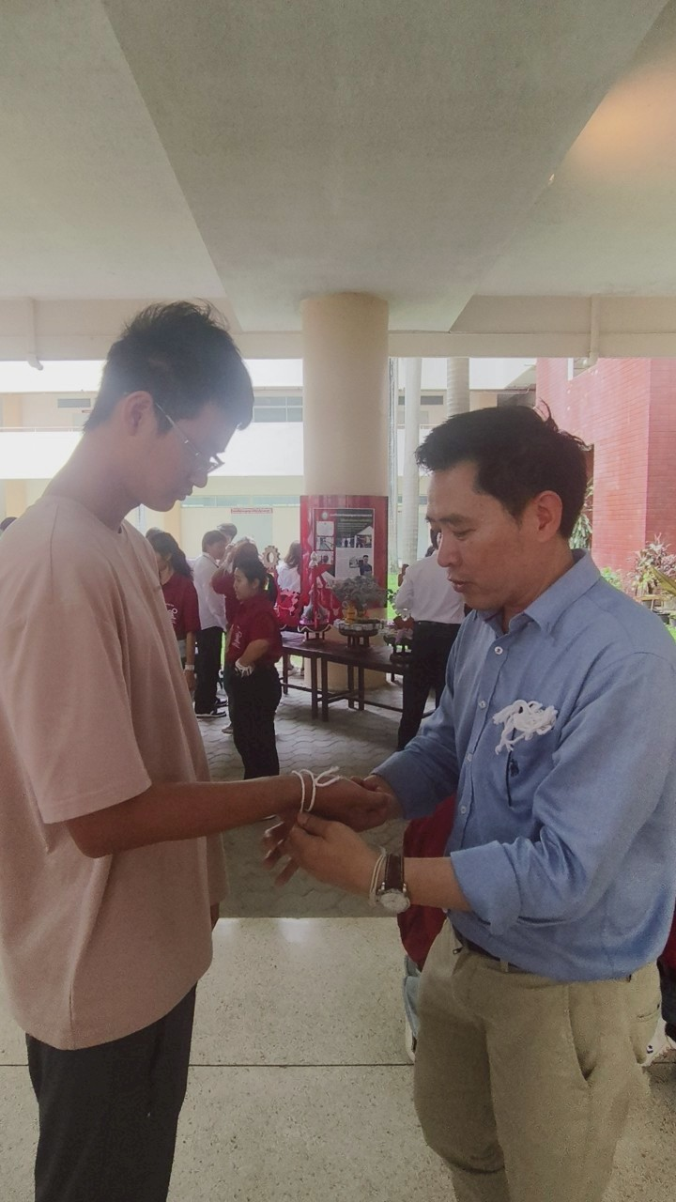
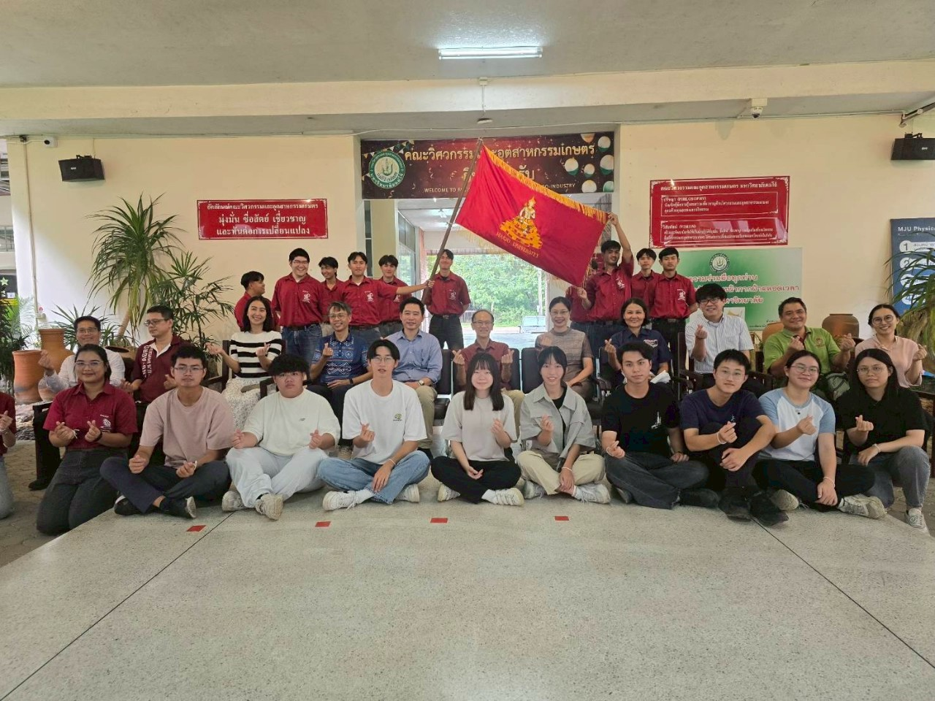
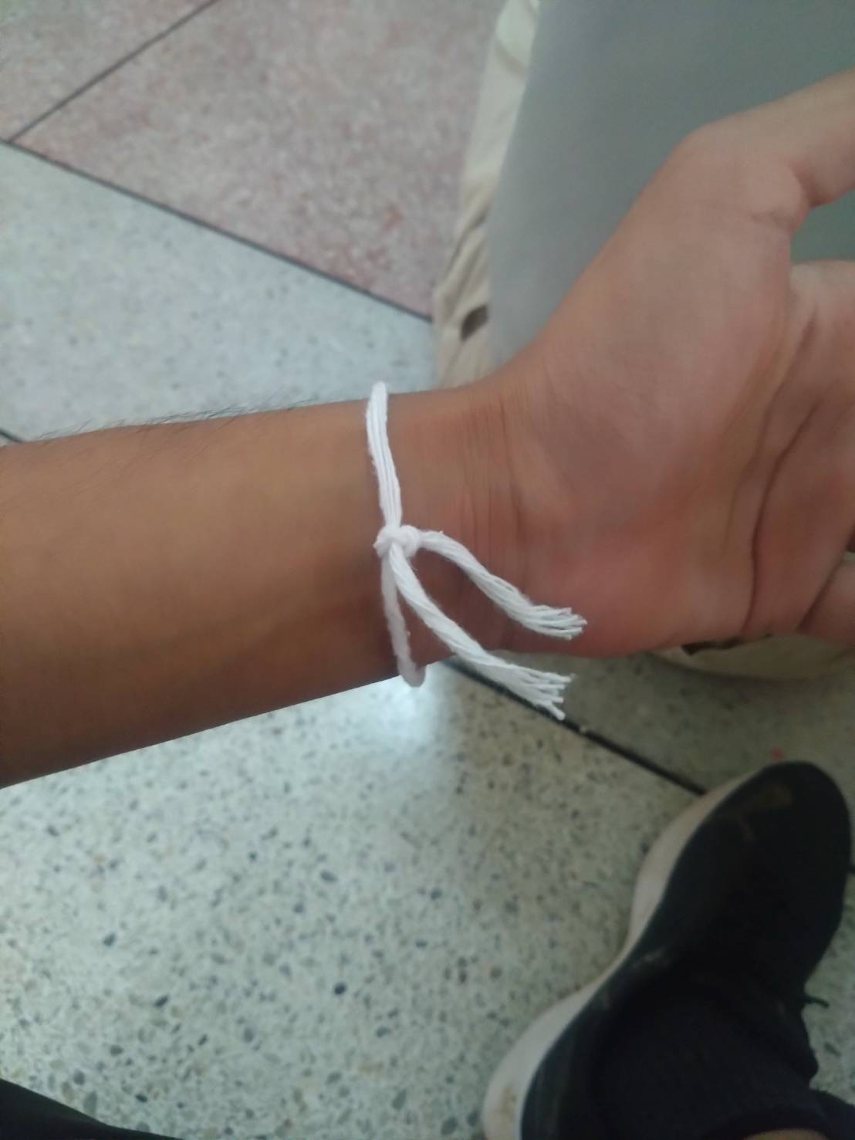
Teacher's Appreciation Day

Slide 9
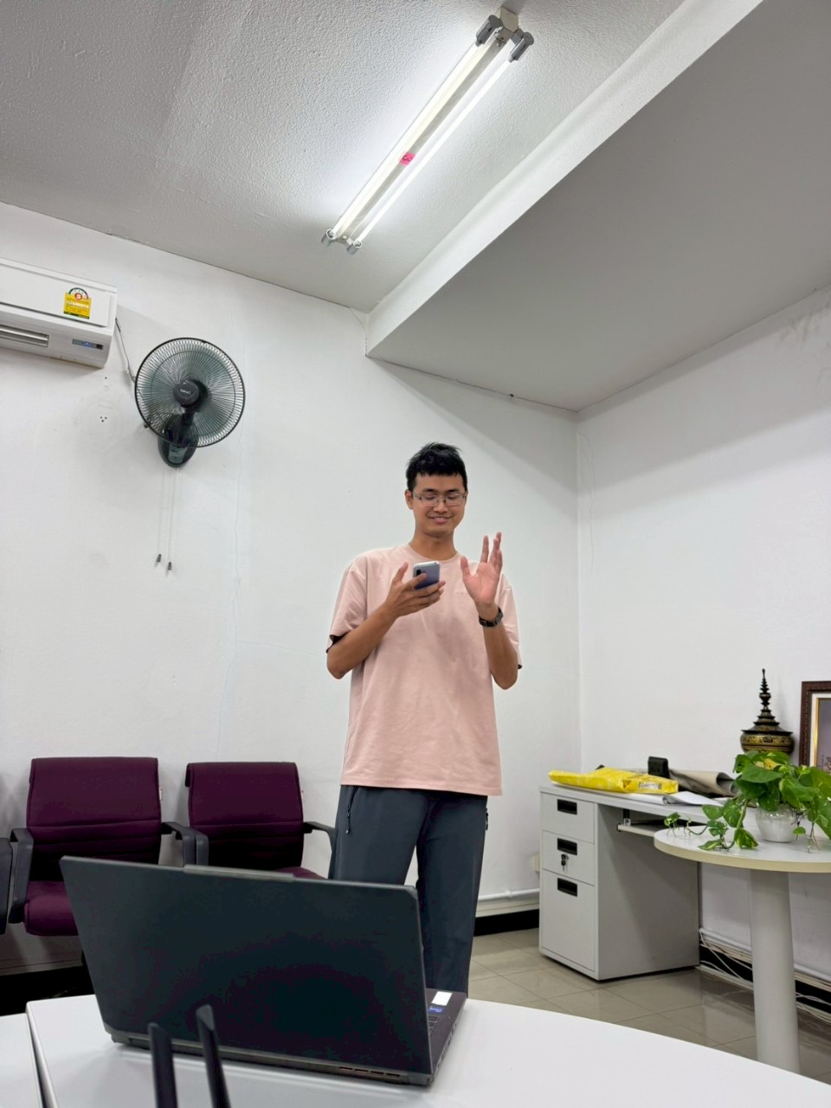
Challenge
Be brave to have conversations in English
For me, the most difficult challenge was language and communication.
Because my English is not very good, at the beginning I couldn’t really understand what the teachers were saying — especially when they used professional or technical words. It was hard for me to follow the class.
But slowly, I started to understand more and more. After 35 days of learning, I feel I’m not the same as before — now I’m more comfortable to speak, and I’m not so afraid to open my mouth and try to talk.

Slide 10
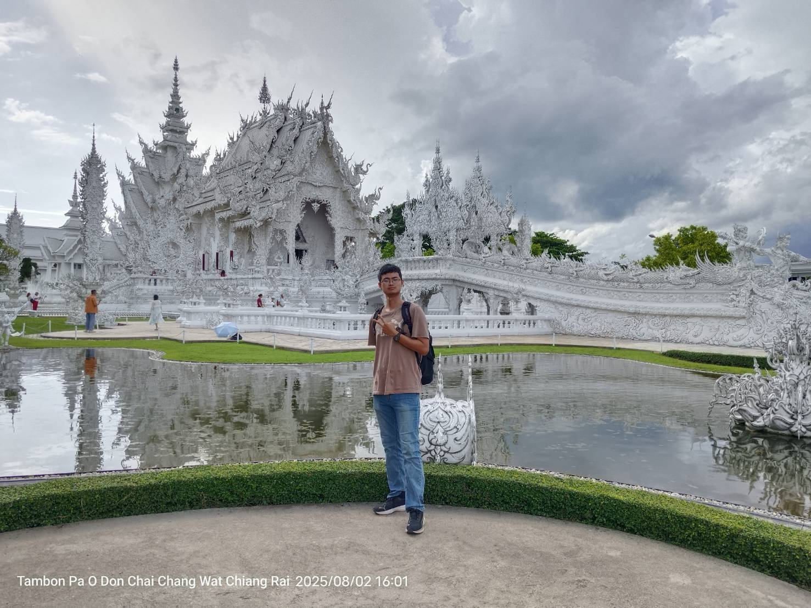
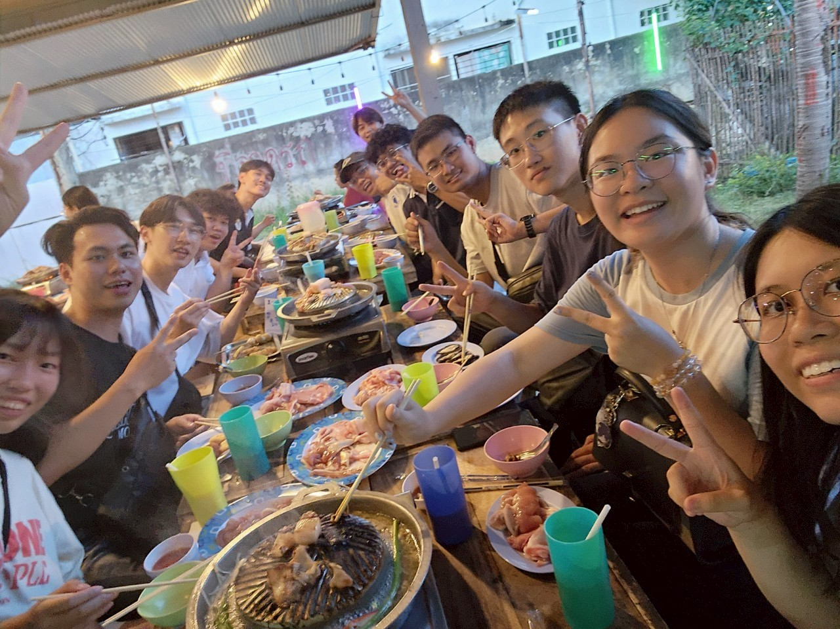
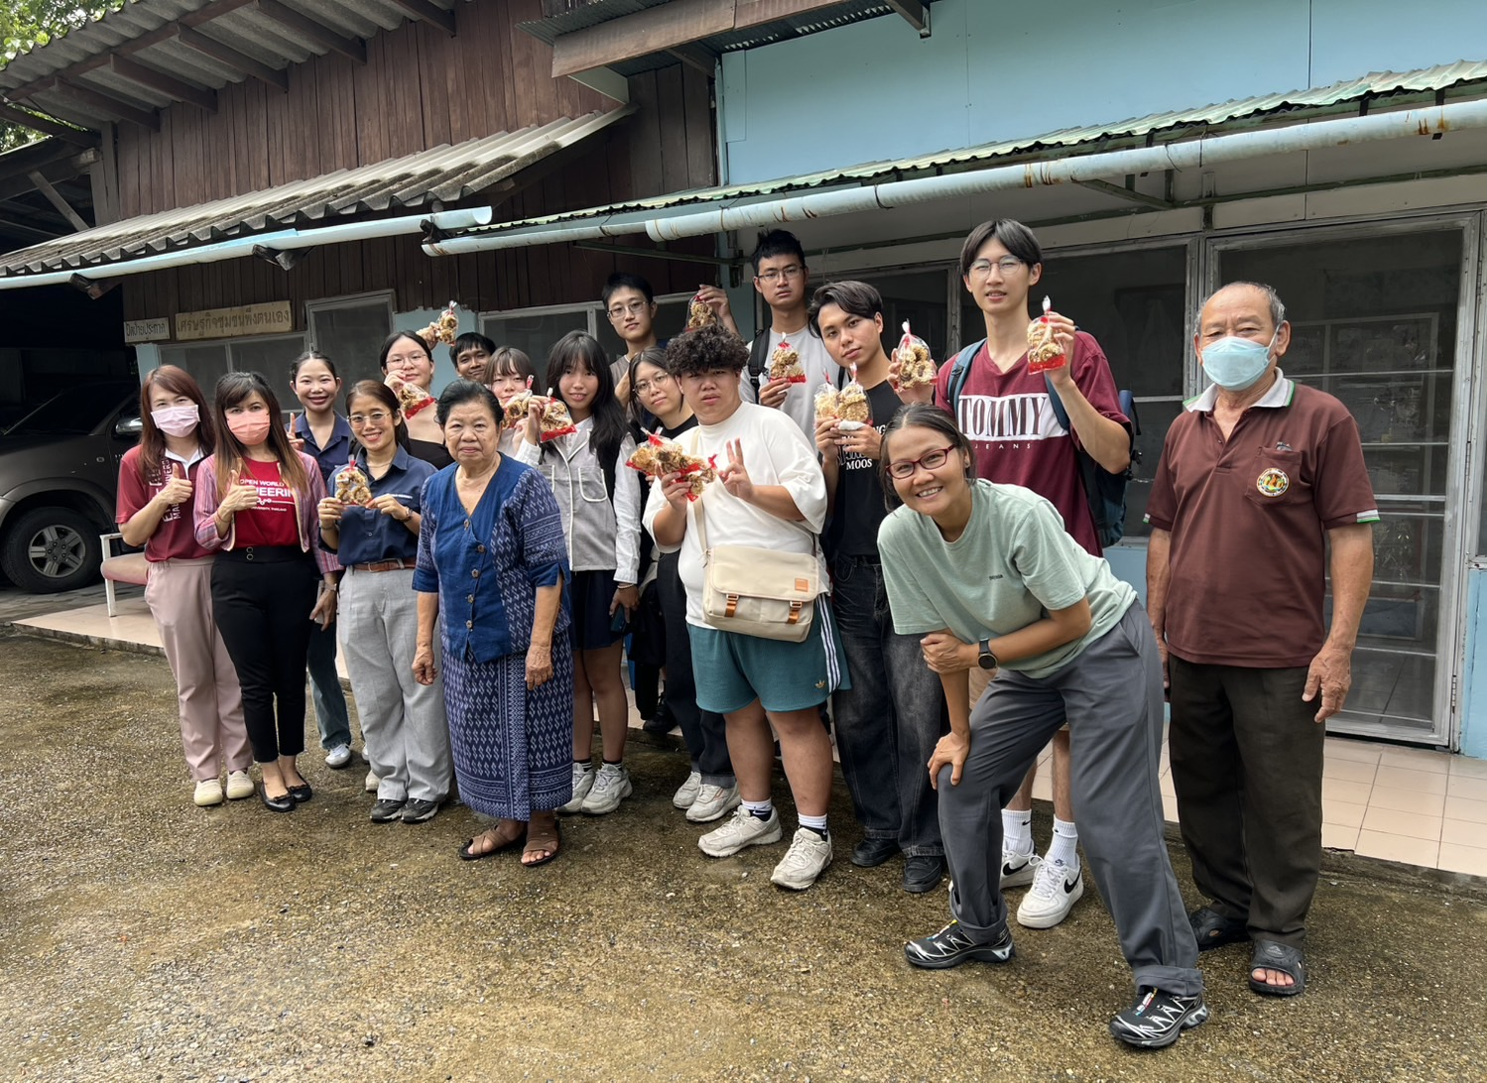
Summarize
For me, this trip to Thailand was not just about learning from others, but about truly understanding and improving myself by leaving my comfort zone and facing challenges. I was not just learning the content in the textbooks, but also learning how to adapt to the new environment with an open mind, learn new skills, and regain confidence from every anxiety and mistake.

Slide 11
Thank you for listen

