Slide 1

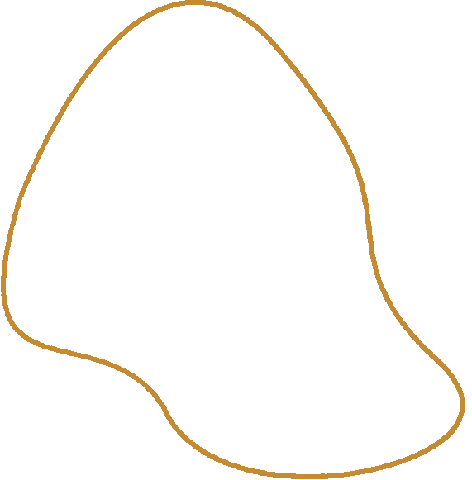

Learning Feedback from Maejo University, Thailand
徐翊琳
HSU,YI-LIN
date：2025-08-09

Slide 2
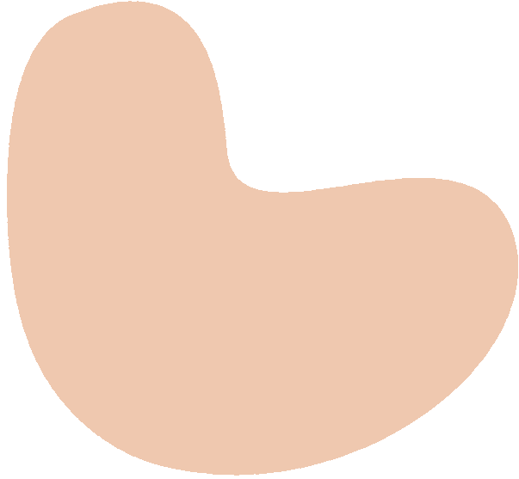
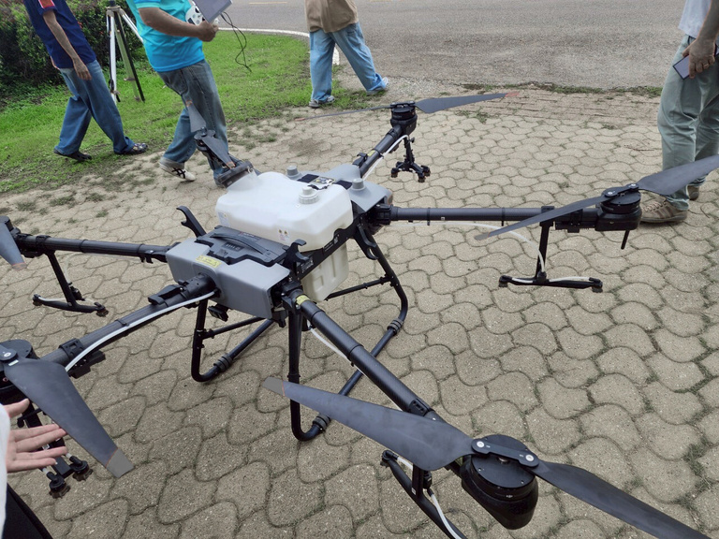
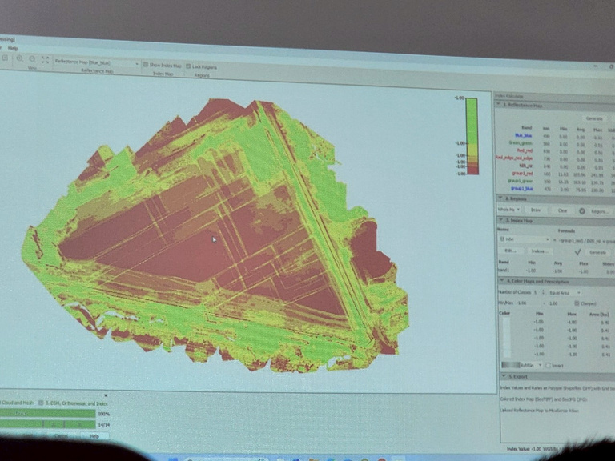
Learn how to use Drones
I already knew a bit about drones, so it was easier for me to keep up with the lessons.
At Meizhou University, I picked up some new stuff like checking crop growth, taking pictures of farmland, and making 3D maps.

Slide 3


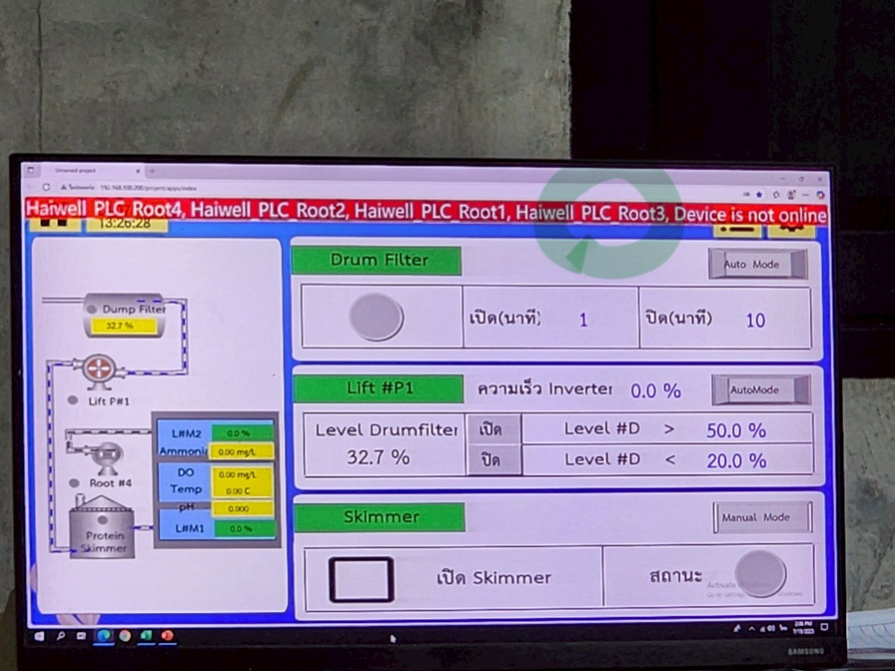

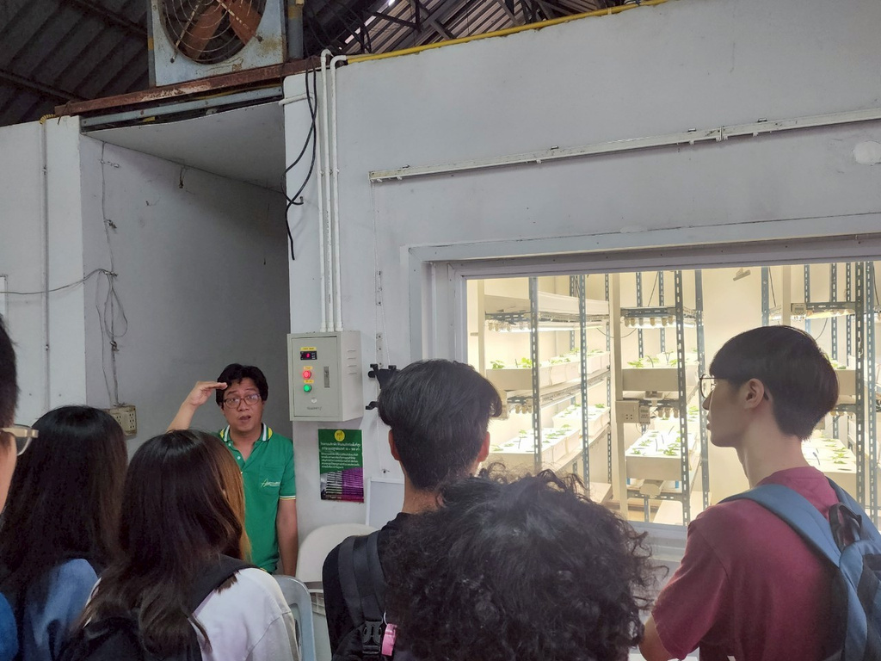
IOT system
Visiting the IoT systems used in fish farming and vertical agriculture helped me understand how IoT is applied in fish pond recycling systems.
I also got to learn about the idea of vertical farming.

Slide 4

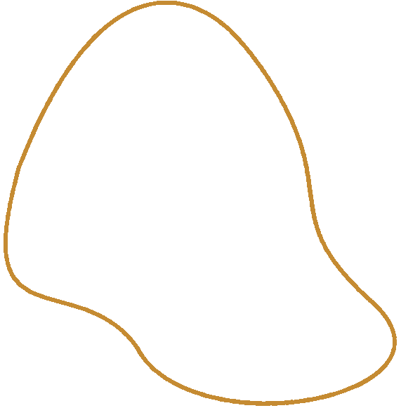
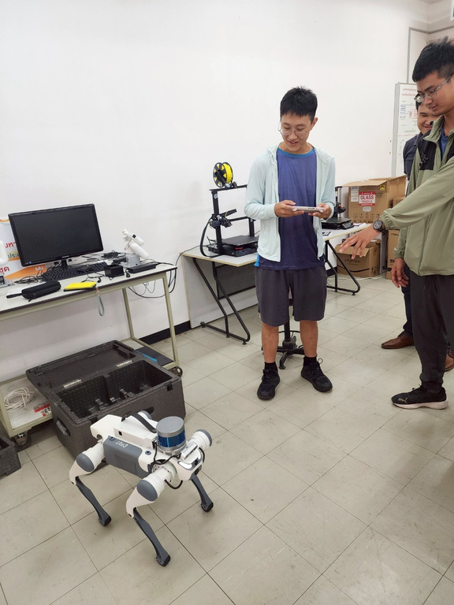
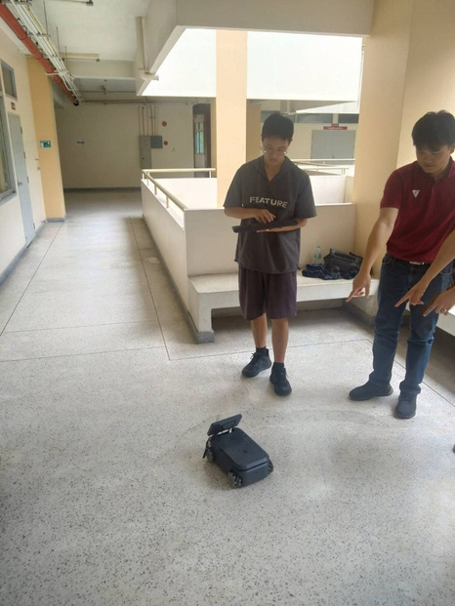
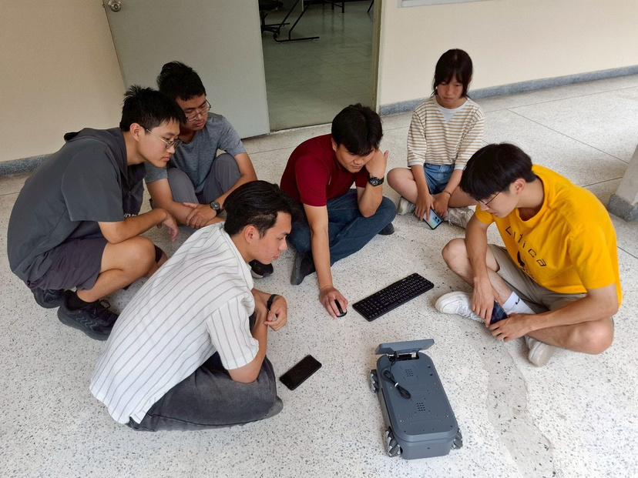
AMR Project
The AMR course gave me a chance to work with robots and learn related stuff, which was really exciting.
Too bad the month went by so fast!

Slide 5
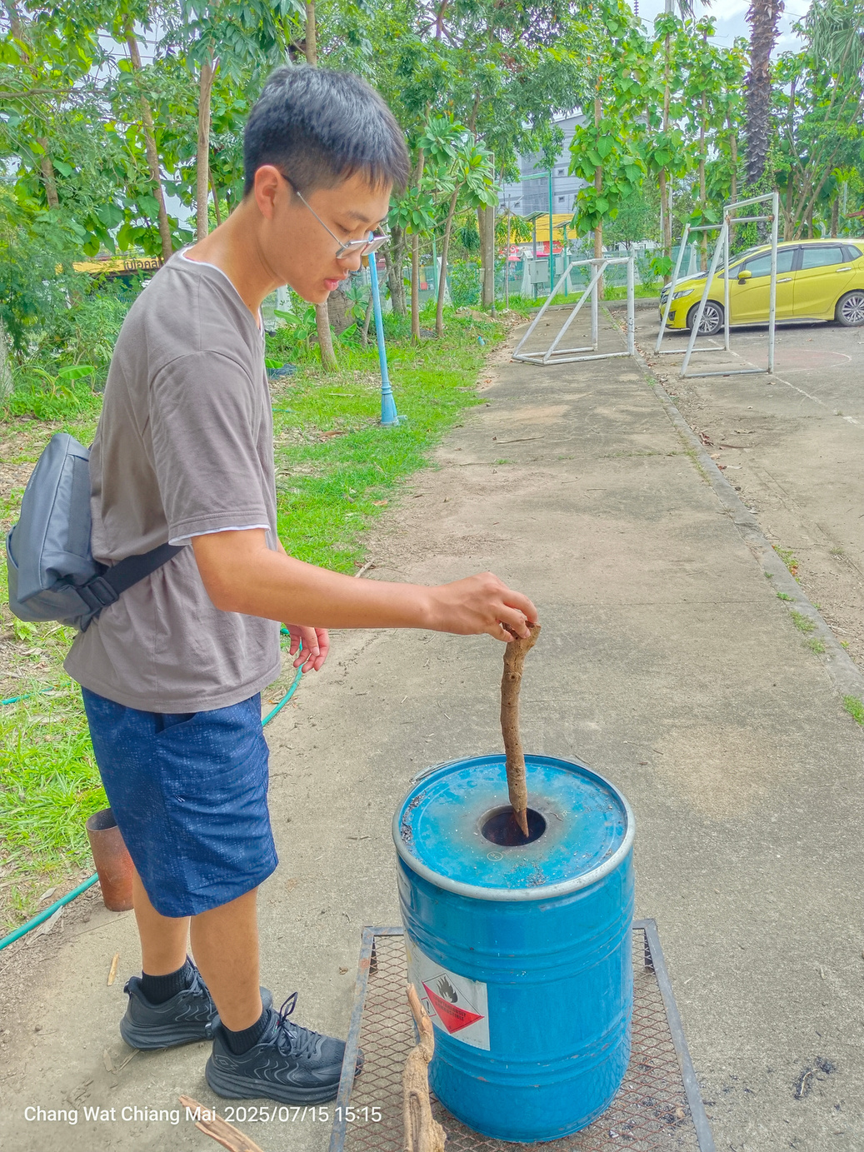
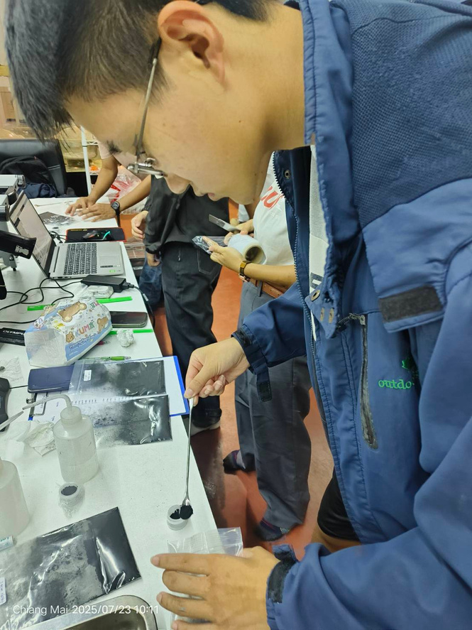
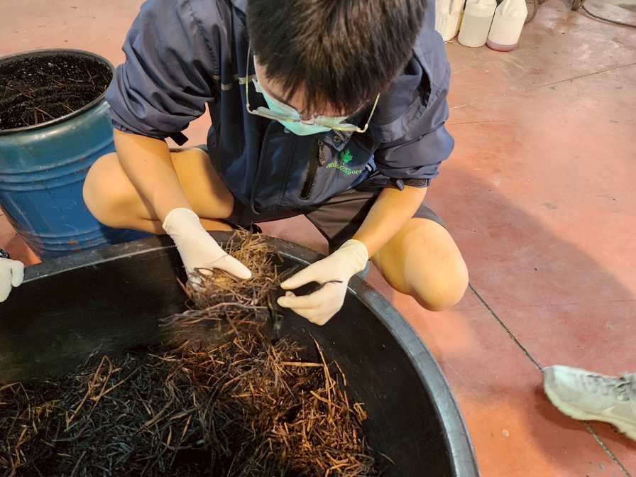
Biochars Project
I already knew about some uses of biochar, but this was the first time I actually learned and worked with it hands-on.
I found out there are steps I didn’t know before, like testing the composition of biochar.
And through this experience, I also learned that biochar can be used in construction

Slide 6

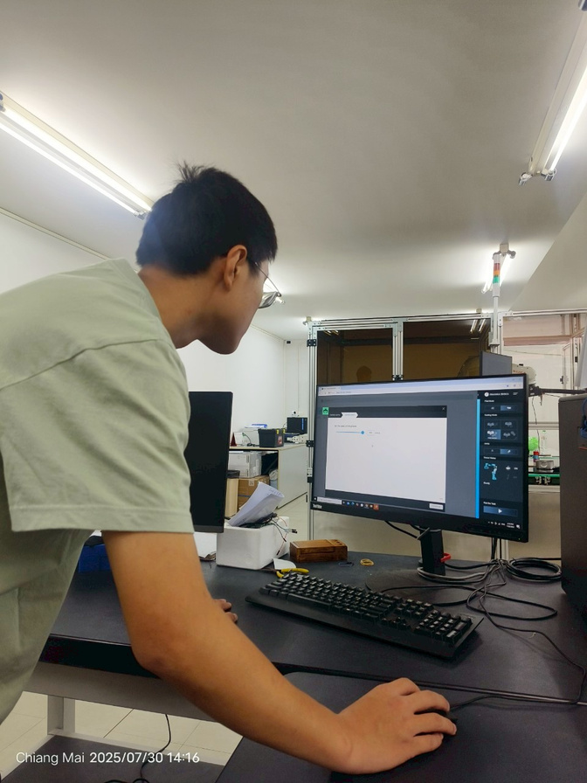
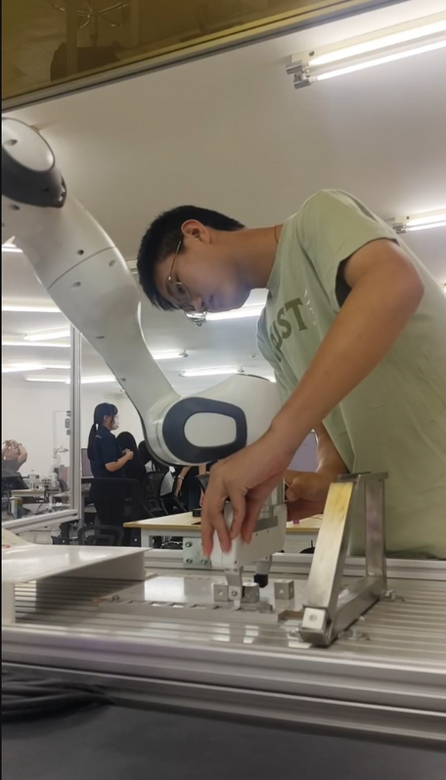
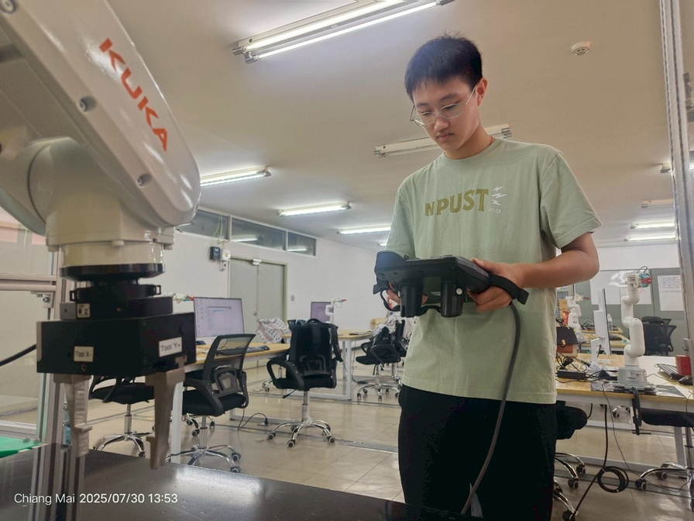
Robotic arm laboratory
The robotic arms really impressed me.
There were three different types, each used in a different way, and I wanted to try them all.

Slide 7
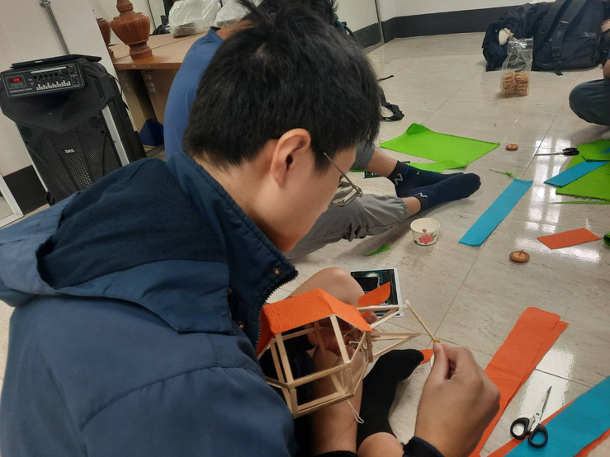
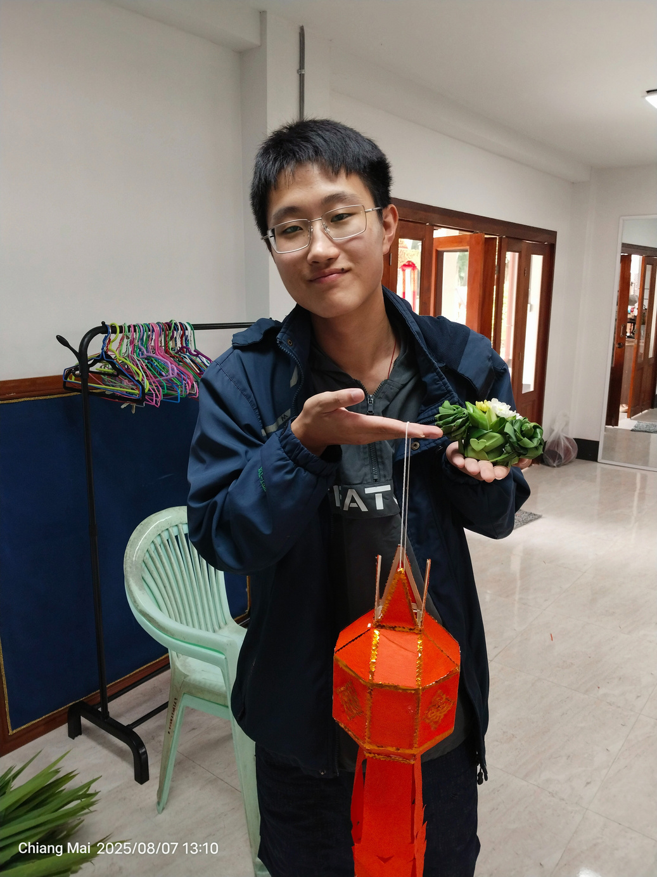
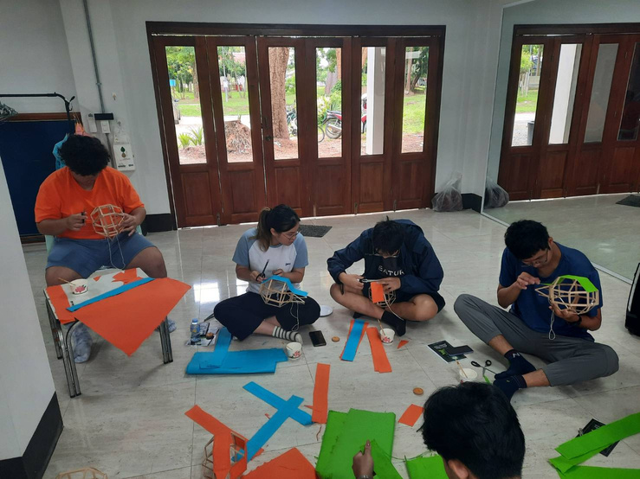

Learn How to Make Yi Peng Lantern Making &Pandan Leaf Folding
I learned how to fold a rose here and even finished part of a lantern.
I had to practice the rose a few times, but luckily the teacher was really patient with us.
I felt really happy once I finished it!

Slide 8

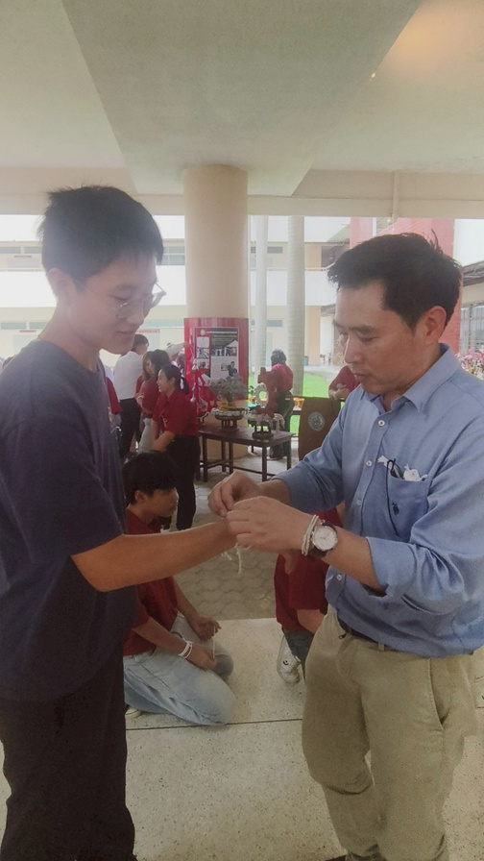
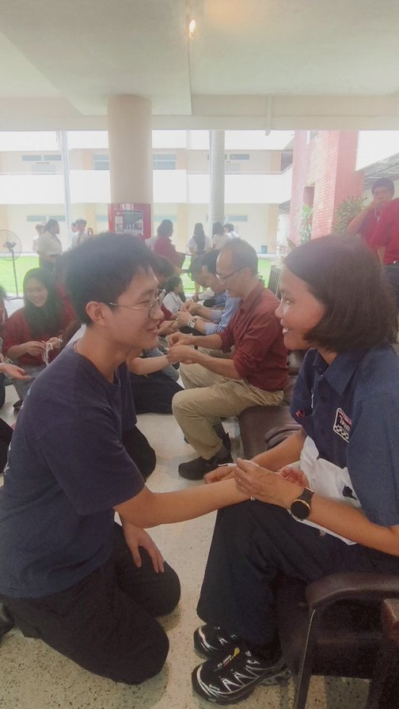
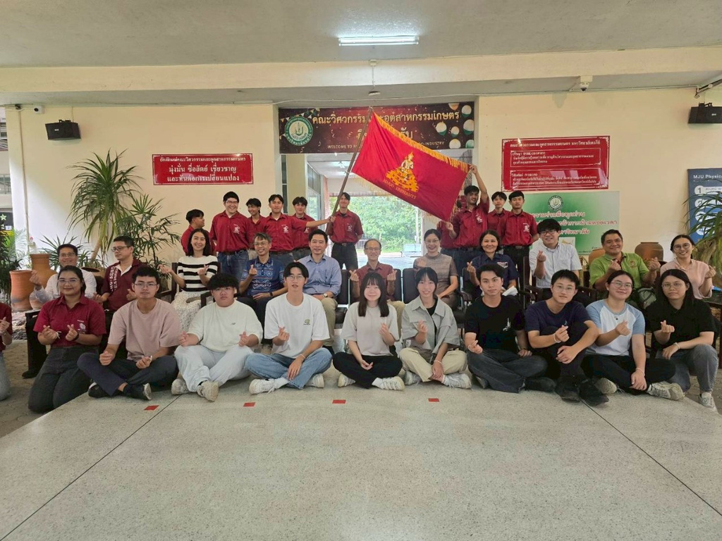
Teacher's Appreciation Day
I had no idea what the schedule was for that activity.
But I’m really glad I joined the Teacher’s Appreciation event.
I was completely drawn into the warm and touching atmosphere,
especially when the teacher tied the blessing bracelet on my wrist.
Thank you so much, teacher!

Slide 9
Challenge
The biggest challenge for me was definitely communication. I wasn’t very confident in my English at first,
but after a few days of living and learning
together and with some encouragement from the teachers I realized it wasn’t as hard as I thought.
As long as I tried to speak, there was always a chance to connect.

Slide 10


Thank you for listening

